Slide 1
The Service Value System (SVS)
Section 5

Slide 2
What Is the Purpose of the SVS?

Slide 3
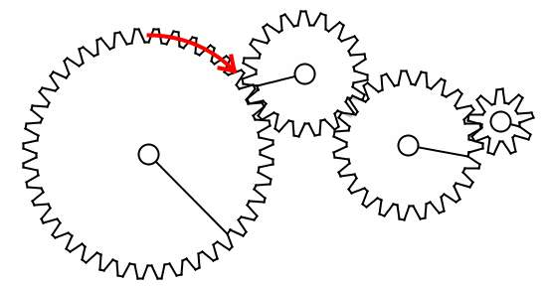
The Service Value System (SVS)
Service Management can properly perform only when it operates as a system
Mapping and understanding the components is essential
This allows for better decisions and better anticipation of their consequences
When two organizations work together their SVS’s should interconnect

Slide 4



The components of the SVS
Guiding Principles
Recommendations usefull for the
organization in all circumstances, regardless of changes in its goals,
strategies, type of work, or management structure.
Continual Improvement
A recurring activity performed to
ensure that an organization’s
performance continually meets
stakeholders’ expectations.
Service value chain
The activities performed by the organization to deliver a product or service to its consumers and enable value
(OPERATING MODEL)
Opportunity/ Demand
Value
Governance
Providing direction and control for the organization.
Practices
Sets of organizational resources
used for performing repetitive
tasks and achieveing objectives.

Slide 5
Inputs and Outputs of the SVS
Opportunity and demand are the main inputs of the SVS
Opportunities are options or possibilities to add value for stakeholders or to improve the organization
Demand is the consumer need or desire for products and services
Value should be the main outcome of the SVS

Slide 6
The Main Elements of the SVS
Next Video

